Slide 1
PROJECT TOPIC IOT BUS TRACKER and Optimization
Abstrct:
At present, In our college the bus system is complexed. Daily morning catching the college bus is an hard task for everyone. There are no constant bus timing. Which lead to the student to miss the bus and it hard to take attendance for the faculty everyday and It hard to check the student require a great man power for cross validating the attendance note. Which is in pen and paper traditional procedure. It hard to see the past record need to spend time to search the records.
Notes:
1

Slide 2
Our Project :
Bus Tracker with automated attendance management system. An Iot Device is installed in bus that give the location of bus to the specific bus student which helps the studens to find exactly where the bus and helps to catch the bus as eaarly as possibile. For the faculty attendance the current system is upgraded by the latet technology It will be digitalized
An specific mobile application will be designed and developed as much privilage according who logging in. Using that Application student can able to track their bus route and bus timing and the faculty can mark attendence by their mobile phone which is less time consuming and with high efficiency
Impact in Current System :
By Implementing our Idea in a real time. Both student and faculty are started to use the application for automatic their work. Our application will keep track the attendance and able to view the past record of attendance on few taps. By the students can never miss the buses they know the location of the bus their route and the location
Implementation :
We have developed an adorable iOT device which connect transmit the location of bus. Tracked location is efficiently shown to the user via a mobile application which act as an intermediate between the staff and parent. Our product ready to implement product. An user adorable UI will be designed and developed.

Slide 3
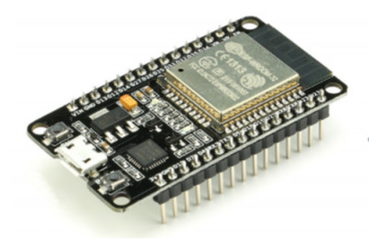
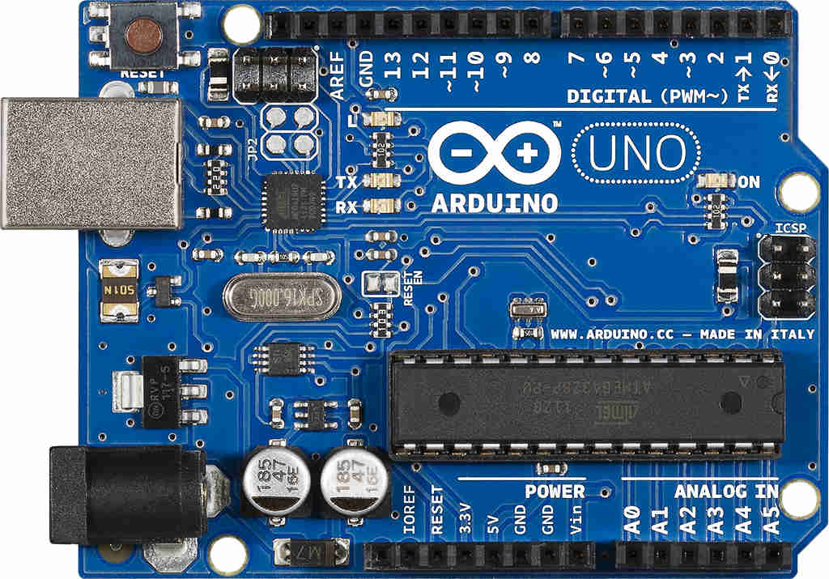
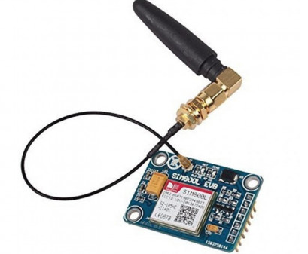
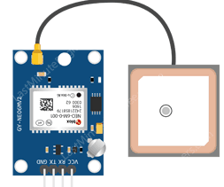
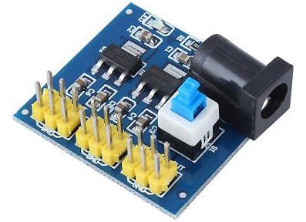
iOT E-Transport ?
Why we Need iOT ? iOT Internet of Things. Our device is connected with the cellular data and the GPS Satellite to get the live location of Bus. Without any human intraction the device will helps us to get the location of Bus which is more efficient then a man power
Our AIM in the Transport System ? Bus Tracker with automated attendance management system. An Iot Device is installed in bus that give the location of bus to the specific bus student which helps the studens to find exactly where the bus and helps to catch the bus as eaarly as possibile. For the faculty attendance the current system is upgraded by the latet technology It will be digitalized An specific mobile application will be designed and developed as much privilage according who logging in. Using that Application student can able to track their bus route and bus timing and the faculty can mark attendence by their mobile phone which is less time consuming and with high efficiency
Notes:
3

Slide 4
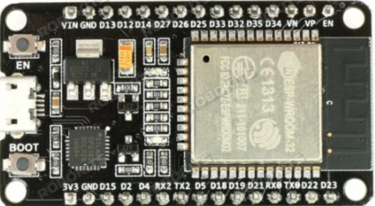
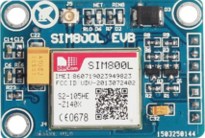
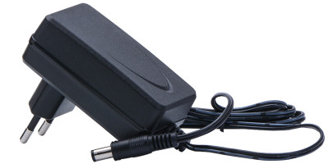
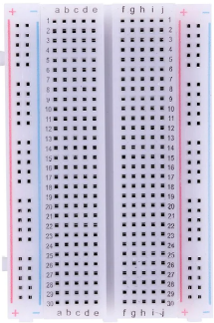
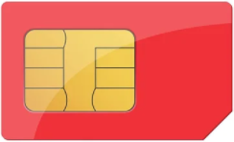
Development Cost
Item | Name & Qty | Price
 | Ardino Uno [x 1] Data cabel [x 1] | 1x655 = Rs. 655 1 x 50 = Rs. 50
 | Neo 6M [x 3] | 3 x 265 = Rs. 795
 | ESP32 Dev [x 1] | 1 x 380 = Rs. 380
 | DC – DC [x 1] | 1 x 80 = Rs. 80
 | GSM SIM800L [x 1] | 1 x 615 = Rs. 615
 | 6V 1A Power [x 1[ | 1 x 150 = Rs. 150
 | Breadboard [x 1] Jumper wire [x 25] GSM Simcard [x 1] | 1 x 42 = Rs. 42 25 x 2 = Rs. 50 1x 200 = Rs. 200
TOTAL COST : Rs. 3017.00
https://www.electronicscomp.com
Notes:
4

Slide 5
WI-FI Product Cost
Item | Name & Qty | Price
 | Neo 6M [x 1] | 1 x 265 = Rs. 265
 | ESP32 Dev [x 1] | 1 x 380 = Rs. 380
 | DC – DC [x 1] | 1 x 80 = Rs. 80
 | 6V 1A Power [x 1] | 1 x 150 = Rs. 150
 | Breadboard [x 1] Jumper wire [x 4] | 1 x 42 = Rs. 42 4 x 2 = Rs. 8
* Require Hotspot [Cost Rs.1500 - 2000]
TOTAL COST : Rs. 2625.00
https://www.electronicscomp.com
Notes:
5

Slide 6
GSM Product Cost
Item | Name & Qty | Price
 | Ardino Uno [x 1] | 1x655 = Rs. 655
 | Neo 6M [x 1] | 1 x 265 = Rs. 265
 | DC – DC [x 1] | 1 x 80 = Rs. 80
 | GSM SIM800L [x 1] | 1 x 615 = Rs. 615
 | 6V 1A Power [x 1[ | 1 x 150 = Rs. 150
 | Breadboard [x 1] Jumper wire [x 10] GSM Simcard [x 1] | 1 x 42 = Rs. 42 10 x 2 = Rs. 20 1x 100 = Rs. 100
* Subscribe to the SIM card cost less than 100 per month
TOTAL COST : Rs. 1925.00
https://www.electronicscomp.com
Notes:
6

Slide 7
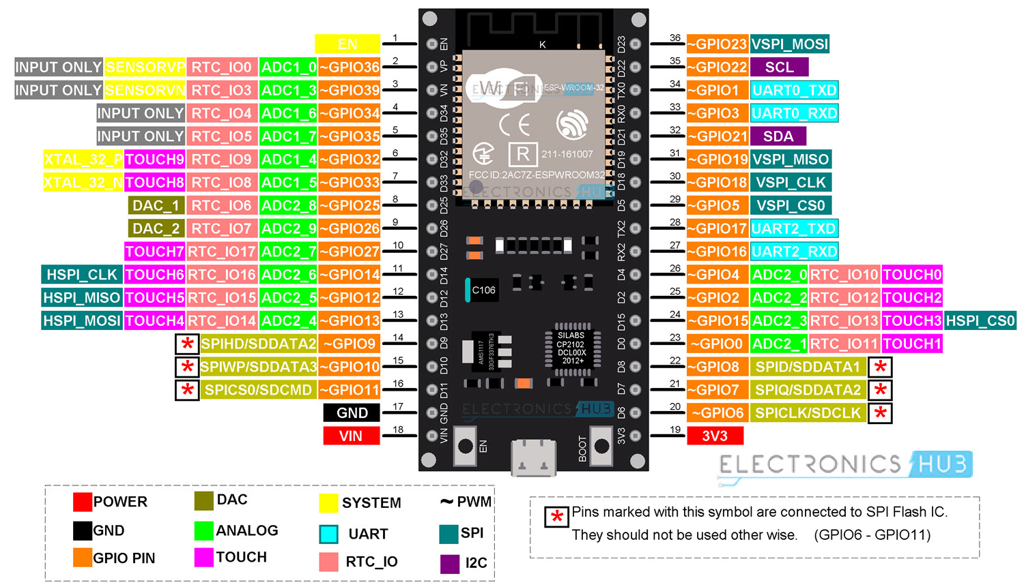
HARDWARE DETAILS
ESP32 Development Board with Wifi and Bluetooth
ESP32 Development board is based on the ESP WROOM32 WIFI + BLE Module.It's a low-footprint, minimal system development board powered by the latest ESP-WROOM-32 module and can be easily inserted into a solderless breadboard.
It contains the entire basic support circuitry for the ESP-WROOM-32, including the USB-UART bridge, reset- and boot-mode buttons, LDO regulator and a micro-USB connector. Every important GPIO is available to the developer.
Features:-
Small volume, easily embeded to other products
Strong function with support LWIP Protocol, Freertos
Suppporting three modes : AP, STA, and AP+STA
Supporting Lua program, easily to develop
Includes CP2102 USB-UART bridge
The ESP32's operating voltage range is 2.2 to 3.6V. Under normal operation the ESP32 Thing will power the chip at 3.3V. The I/O pins are not 5V-tolerant! If you interface the board with 5V (or higher) components, you'll need to do some level shifting.
Notes:
7

Slide 8
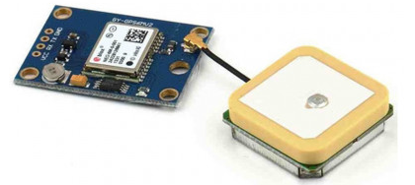
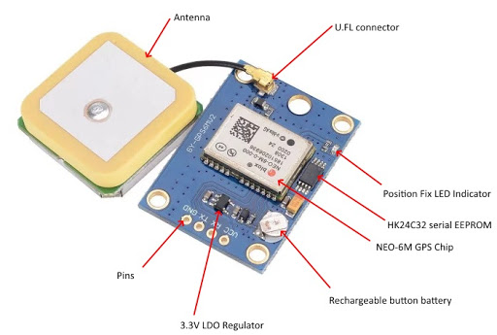
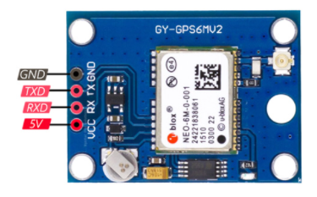
HARDWARE DETAILS
NEO-6M GPS Module
This is a complete GPS module that is based on the NEO-6M. This unit uses the latest technology to give the best possible positioning information and includes a larger built-in 25 x 25mm active GPS antenna with a UART TTL socket
Features :-
5Hz position update rate
Operating temperature range: -40 TO 85°CUART TTL socket
EEPROM to save configuration settings
Rechargeable battery for Backup
The cold start time of 38 s and Hot start time of 1 s
Supply voltage: 3.3 V
Configurable from 4800 Baud to 115200 Baud rates. (default 9600)
SuperSense ® Indoor GPS: -162 dBm tracking sensitivity
Support SBAS (WAAS, EGNOS, MSAS, GAGAN)
Separated 18X18mm GPS antenna
The operating voltage of the NEO-6M chip ranges from 2.7 to 3.6V. But the good news is, this module comes with MICREL’s MIC5205 Ultra-Low Dropout 3V3 regulator.
The logic pins are also 5-volt tolerant, so we can easily connect it to Arduino or any 5V logic microcontroller without using a logic level converter.
Notes:
8

Slide 9
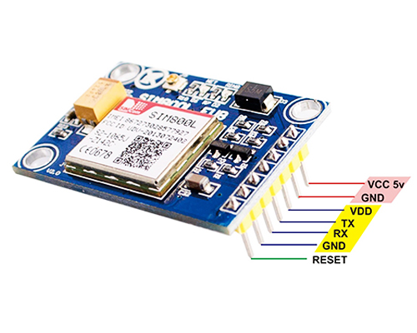
HARDWARE DETAILS
SIM800L V2.0 5V Wireless GSM GPRS MODULE
SIM800L V2.0 5V Wireless GSM GPRS MODULE power supply for 5 v, computer debug USB to TTL serial port. Power to the output current of 800 ma, TTL serial interface is compatible with 3.3 V and 5 V micro-controller, can be directly after purchase and single-chip computer connection.
Features :-
Network support: Quad-Band 850/900/1800/1900 MHz works on GSMnetworks in all countries across the world.
TTL serial interface compatible with 3.3V and 5V MCU
The small size is suitable for all kinds of sleeve belt type and embedded.
playing card slot, convenient change mobile phone card.Can side reserve replacement cell phone bayonet into the box.
using the IPX interface can arbitrarily change the antenna. The default PCB antenna greatly reduces: use the space.
the board with gold plated board, more stable performance.
when wiring neat guarantee board running more stable.
while SIM800L V.2 GSM/GPRS module already has a built-in regulator circuit and TTL level converter on the board.
Input Supply Voltage (VDC) 5 - 20
Notes:
9

Slide 10
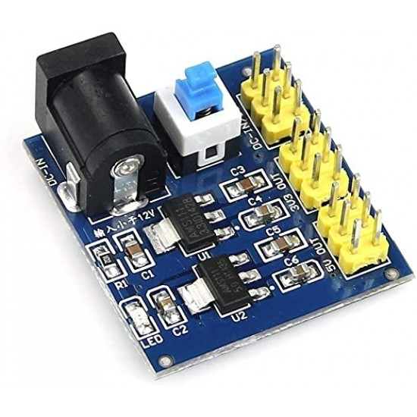
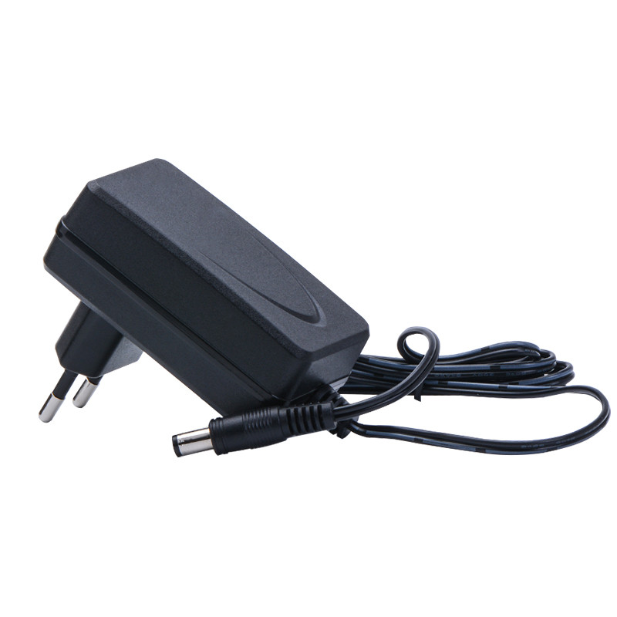
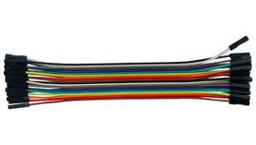
HARDWARE DETAILS
Adapter | DC-DC Regulator | Jumper Wire
Adapter - 6 Volt 1 Amp Power Adapter takes an AC INPUT of 100-240V and gives 6V 1A DC output
Regulator - This DC-DC 12V to 3.3V 5V 12V Power Module Multi Output Voltage Conversion is also known as Buck Converter or also as Step-Down Voltage Converter. The module is capable of altering the output of the power source/supply before supplying it to the load so as to deliver the specified power to your load.
The device is very flexible and easy to use. The module is powered by 6V to 12V DC input, and provides three fixed DC outputs: 3.3V, 5.0V, and a third output which is a direct connection to the DC input(input to the module).
Jumper Wire - A jumper wire is an electric wire that connects remote electric circuits used for printed circuit boards. By attaching a jumper wire on the circuit, it can be short-circuited and short-cut (jump) to the electric circuit.
Notes:
10

Slide 11
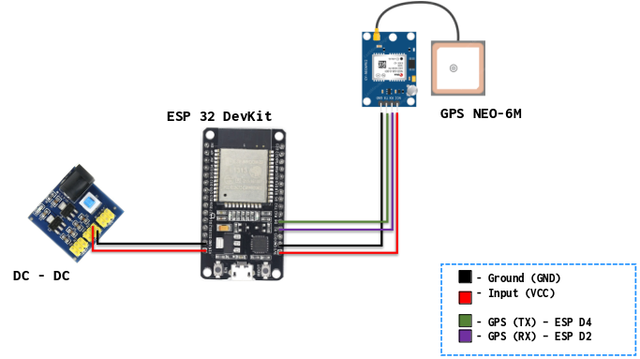
WIFI CIRCUIT DIAGRAM
Notes:
11

Slide 12
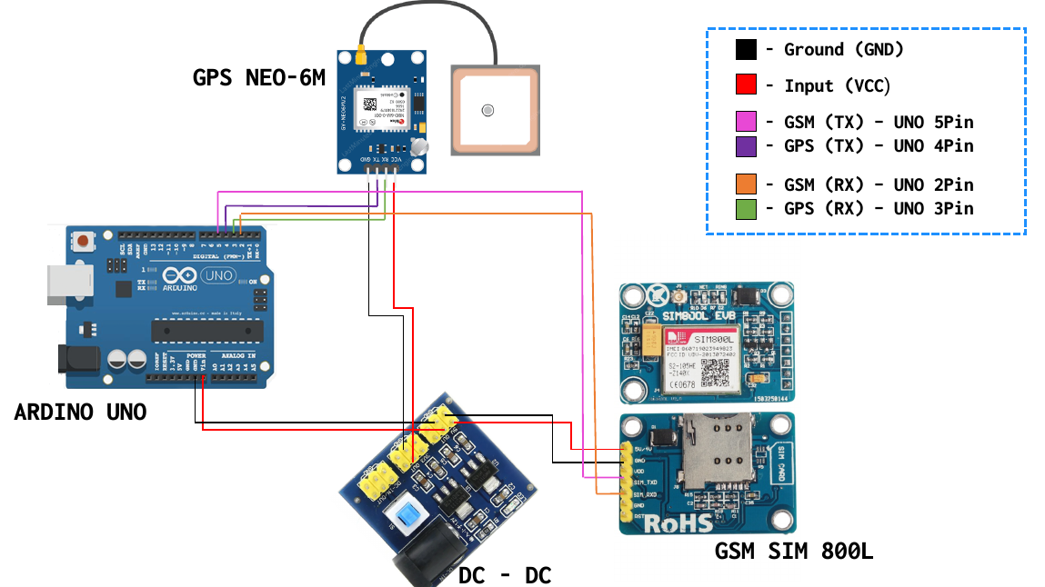
GSM CIRCUIT DIAGRAM
Notes:
12

Slide 13

Notes:
13

